Slide 1
Prostate and Breast Cancer Possible Ways to Reduce Your Chances
Dr. Frank F. Mallory
Full Professor and Past Chair
Department of Biology
Laurentian University
Sudbury, Ontario
CANADA

Slide 2
If You Google
Age and Testosterone

Slide 3
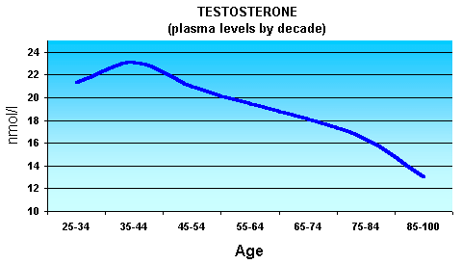
In Males, Natural Testosterone Production Starts to Decline in the Early 30’s

Slide 4
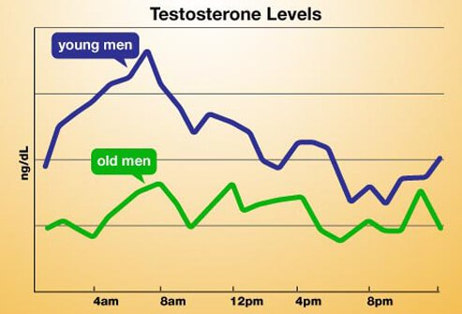
Natural Testosterone Levels Also Vary with Time of Day

Slide 5
Consequences of Low Testosterone
Depression
Fatigue
Weakness
Loss of Sex Drive (decreased libido)
Hair Loss
Weight Gain
Irritability
Decreased Bone Density
Shrinking Muscles

Slide 6
In Women
Women also produce small amounts of testosterone and other androgens from their adrenal glands and ovaries
These hormones affect libido, a fancy word for “General Horniness Syndrome”
Low androgen levels affects sexual desire and pleasure and the incidence of Sex

Slide 7
Possible Options Anabolic Steroids
What are anabolic steroids?
Anabolic steroids are synthetic variations of the male sex hormone testosterone.
Some common names for anabolic steroids are Gear, Juice, Roids, and Stackers.

Slide 8
Possible Benefits Anabolic Steroids
Improve physical appearance • Increase muscle mass • Increase strength and endurance • Train longer and frequently with unprecedented intensity
• Boost sporting performance • Faster recuperation
Can>Increase sex drive and primary sex characteristics

Slide 9
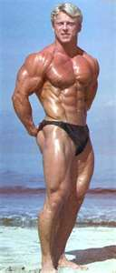
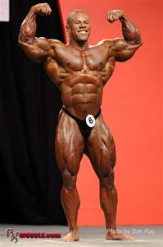
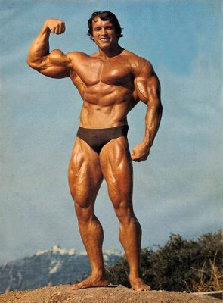
Anabolic Steroids

Slide 10
Possible Side Effects Anabolic Steroids
Short-Term Effects
Abuse of anabolic steroids may lead to mental problems, such as:
paranoid (extreme, unreasonable) jealousy
extreme irritability
delusions—false beliefs or ideas
impaired judgment

Slide 11
Possible Side Effects Anabolic Steroids
Long-Term Effects
Anabolic steroid abuse may lead to serious, even permanent, health problems such as:
kidney problems or failure
liver damage
enlarged heart, high blood pressure, and changes in blood cholesterol, all of which increase the risk of stroke and heart attack, even in young people

Slide 12
Possible Side Effects Anabolic Steroids
Several other effects are gender- and age-specific:
In men:
shrinking testicles
decreased sperm count
baldness
development of breasts
increased risk for prostate cancer

Slide 13
Possible Side Effects Anabolic Steroids
In women:
growth of facial hair or excess body hair
male-pattern baldness
changes in or stop in the menstrual cycle
enlarged clitoris
deepened voice
In teens:
stunted growth (when high hormone levels from steroids signal to the body to stop bone growth too early)
stunted height (if teens use steroids before their growth spurt)

Slide 14
Clearly Natural Testosterone/Androgen Boosters are Safer
Ejaculation Abstinence
Think about having Sex
Having Sex
Watching Pornography-
studies have shown that males can increase their testosterone (androgen) levels by 100% and females by 80%.

Slide 15
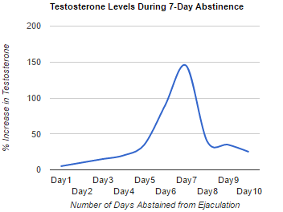
Ejaculation Abstinence

Slide 16
If You Google
Pornography and Testosterone

Slide 17
Pornography
Escasa et al [2011] analysed the effect of sexual visual stimuli on T levels in 44 males in a swingers club–T levels increased by 11%.
Cook et al (2012) showed that T levels increased with erotic films, decreased with sad films, while aggressive films significantly increased cortisol.
Hellhammer et al (1985)> T levels increased by 35% after sexually explicit films– increasing from 15 minutes and peaking at 60-90 minutes after the end of the film –men also reported increased motivation, competitiveness, and decreased exhaustion
Other studies showed pornography increased testosterone levels by 100% in males and androgens by 80% in females
Androgens are directly associated with male and female libido

Slide 18
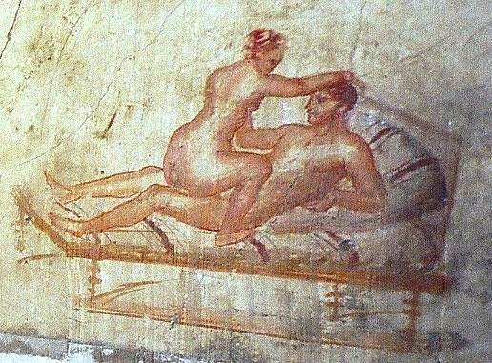
Early Pornography Pompeii-Roman Empire

Slide 19
If you Google
Prostate Gland

Slide 21
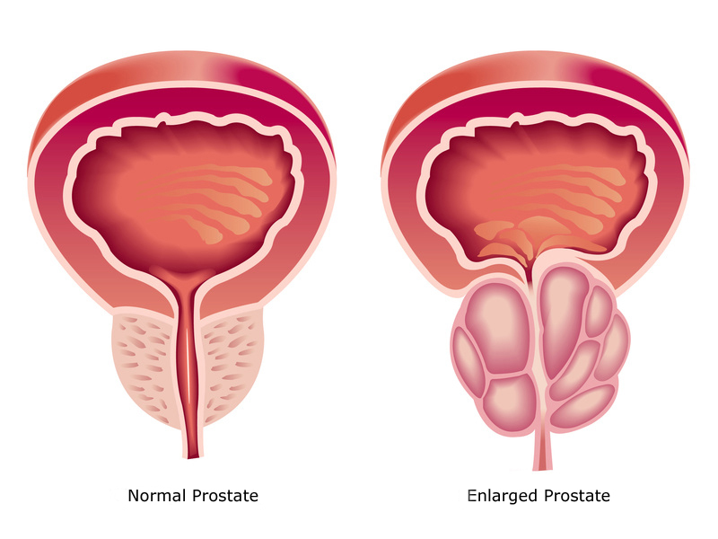
Normal and Begin Prostate Hyperplasia

Slide 22
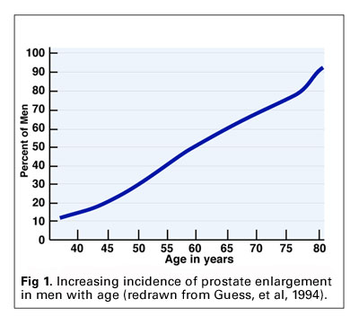
Prostate Enlargement with Age

Slide 23
If You Google
Prostate Cancer

Slide 24
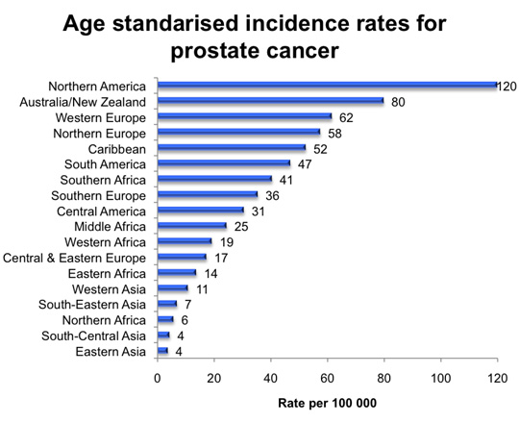
Prostate Cancer Rates/Country

Slide 25
Prostate Cancer Stats-Canada
2017
21,300 men diagnosed with prostate cancer
21% of all new cases of cancer in men
4,100 men will die=10% all male cancer deaths
On average, 58 Canadian males diagnosed every day
On average, 11 Canadian males will die every day
1 in 7 Canadian males will get prostate cancer over their lifetime

Slide 26
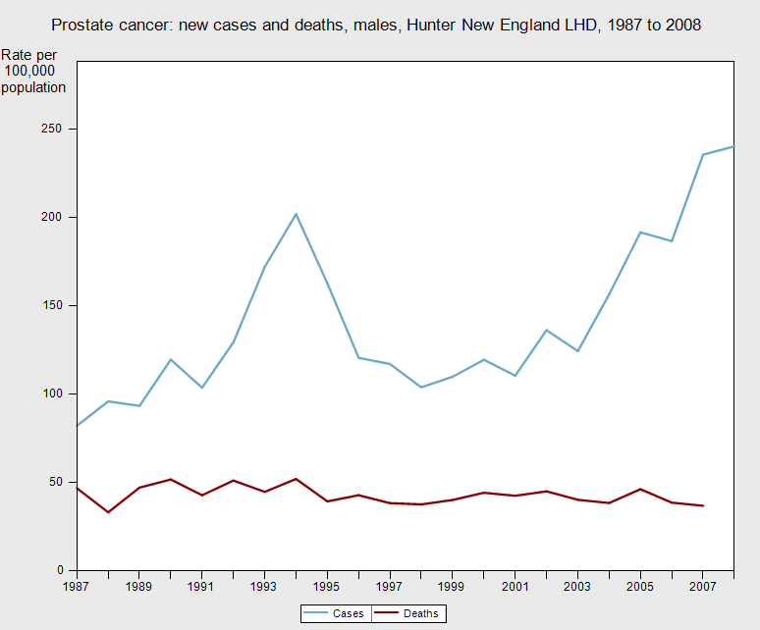
Prostate Cancer Data-New England New Cases vs Deaths

Slide 27
Breast Cancer Stats-Canada
2017
26,300 women were diagnosed with breast cancer
25% of all cancer cases in women
5,000 women died >13% of all cancer cases
On average,72 Canadian women were diagnosed with Breast Cancer every day
On average, 14 Canadian women died every day
1 in 8 Canadian women will develop breast cancer during their lifetime

Slide 28
If You Google
Sex, Prostate and Breast Cancer

Slide 29
Sex and Prostate Cancer
The research suggested that men who said they'd never had sexual intercourse were nearly twice as likely to be diagnosed with prostate cancer.
Men who had slept with more than 20 women were not only markedly less likely to get any type of prostate cancer, but experienced a 19 percent reduction in diagnoses with aggressive types of prostate cancer.
Analyzing questionnaires from more than 3,200 men, Canadian scientists found that men who have sex with more than 20 women had a 28 percent drop in the odds of one day being diagnosed with prostate cancer.

Slide 30
Conclusions
From additional research, it appears that ejaculation frequency — not the number of sexual partners — is the key factor in cutting prostate cancer risk
Female libido and genital system function is directly related to androgen levels mainly originating from the ovaries and adrenal glands and will be sustained by the increased levels as well.
Menopause in women now occurs on average at 51 years of age

Slide 31
Conclusion
Watch Porn with your partner few times/week
This stimulates Natural Production of Testosterone (Androgens)
This keeps “Mr. Happy” and “Hot and Juicy” functional
Have Sex at least once a week
Reduce chances of Prostate Cancer up to 40%
Reduce chances of Breast Cancer significantly and gain a great family

Slide 32
Conclusion
Breast cancer is least in women who enjoy sex, partner-up, have children and breast feed their children for longer periods of time
Having children at younger ages reduces the chances of breast cancer further
Nuns that are celibate have some of the highest breast cancer rates in society

Slide 33
Conclusion Natural Selection Has Designed Us to:
Use It
or
Loose IT

Slide 34
OTHER FACTORS!!!

Slide 35
The Mallory's

Slide 36
References
Escasa, MJ et al. Salivary Testosterone Levels in Men at a U.S. Sex Club. Arch Sex Behav. 2011; 40: 921-92
Cook, CJ et al. Changes in salivary testosterone concentrations and subsequent voluntary squat performance following the presentation of short video clips. Horm Behav. 2012; 6(1): 17-22
Seo, Y et al. Plasma concentration of prolactin, testosterone might be associated with brain response to visual erotic stimuli in healthy heterosexual males. Psychiatry Investigations 2009; 6(3): 194-203
Hellhammer, DH et al. Changes in saliva testosterone after psychological stimulation in men. Psychoneuroendocrinology. 1985; 10(1): 77-81

